Slide 1

Predicting Innovation
Kyle S. Hanna
Applied Data Scientist, Innovation Intelligence

Slide 2





Goal: Identify inventions that will be patented and licensed
BUSINESS PROBLEM:
The Polsky Center has to work with the general patenting process that is
slow
(~6.5 years to issue patent)
expensive
(~$7,700 to get 1 patent issuance)
uncertain
(70% of patents abandoned)
OPPORTUNITY:
Identify successful patent applications and licensable inventions early in the process, saving 6.5 years of resources and $7,700 in per-patent costs spent on inventions that will later be abandoned.

Slide 3


Below is the current patent process and where the models will be implemented
N
Model 2
What inventions have a high probability of licensing success?
Outreach to Organizations for Licensing
Y
Collect Licensing Revenue
Patent
Licensed?
Y
Y
UChicago Stakeholder Develops Tech for Patenting
Review of Commercial Likelihood / Patentability
Y
Prosecution Process
(3-6 Years)
Move to
Filing?
Patent
Issued?
N
N
Drop Invention from Filing Process
Invention Removed from Issuance Queue
What inventions should the Polsky Center select?
Model 1

Slide 4

Agenda
Introduction
Data Source
Methodology
Model Frameworks
Business Impact
Future Considerations

Slide 5
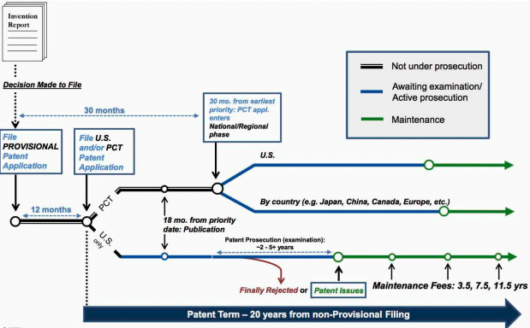
The patent application process is lengthy and costly
Stage 1:
30 Months
Stage 2:
2 to 5+ Years
Stage 3:
3.5 to 11.5 Years
Notes:
Show time associated instead of cost, since we cover that on last slide. Total cost, total time

Slide 6
Our models simplify the decision making process, saving time and resources manually researching inventions
Model | Primary Features | Outcome
Which patents should the Polsky Center select? | Priority Status Market Feedback Patents in Technology Family | Fund / Do not Fund
What inventions have a high probability of licensing success? | Technology Owner Licenses in Technology Date of Filing | Likely to License / Unlikely to License

Slide 7
Data gaps were identified, and mitigation plans were developed for specific features to use in future work
6,800 patent records, 4,000 Technology records, 3,800 Agreement records
Data Gaps
Mitigation Plans
MINOR DATA GAP
< 5% of missing data
Missing Decision Summary
No associated Law Firm
Patent/Licensing Cost Considerations not found
Remove records where a minor data gap is found
Replace null values with “other” for features with categories
Impute values for important features with moderate data gaps
MODERATE DATA GAP
> 5% and < 60% of missing data
Incomplete data on licensing status
15% of data with no Division

Slide 8
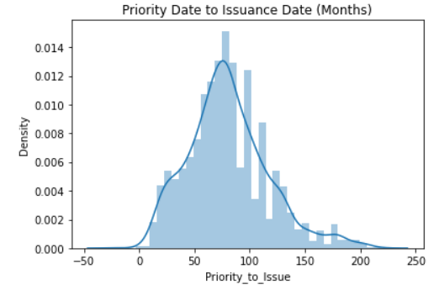
Patents typically take 80 months (~6.5 years) to get issued and varies greatly by Law Firm and Attorney
Patent Issuance Length (in months)
Average = 80 Months
142 Months:
Variance in time to issue between fastest and slowest Law Firm
191 Months:
Variance in time to issue between fastest and slowest Attorney

Slide 9
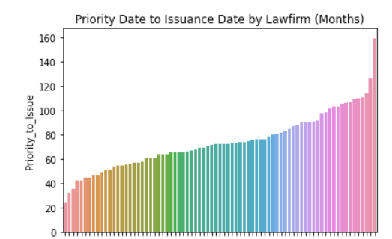
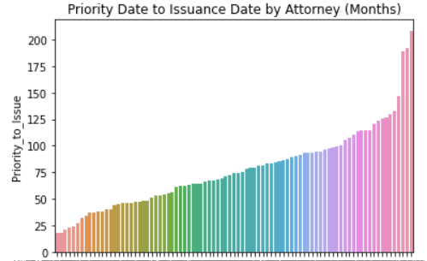
Patenting timeline varies largely by law firm and attorney
Average Patent Issuance Length by Law Firms
(in months)
Average Patent Issuance Length by Attorney
(in months)
Number of months
Number of months
Law Firms
Attorneys
Law Firm X:
2 patent applications
24 months
Law Firm Y:
66 patent applications
160 months
Attorney X:
7 patent applications
18 months
Attorney Y:
11 patent applications
209 months

Slide 10
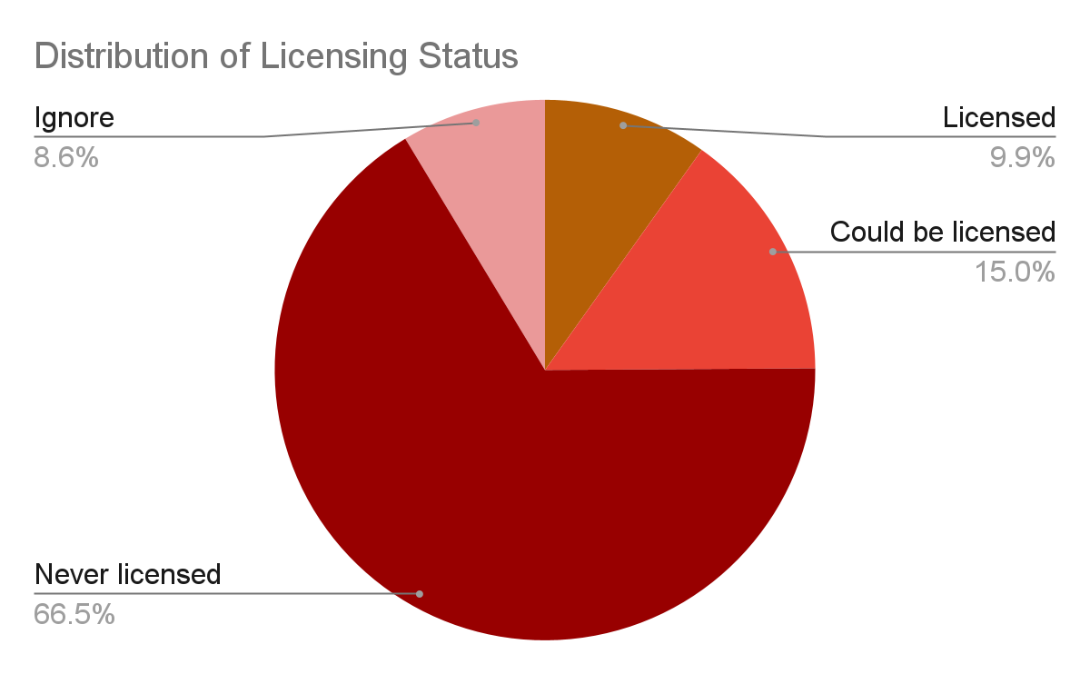
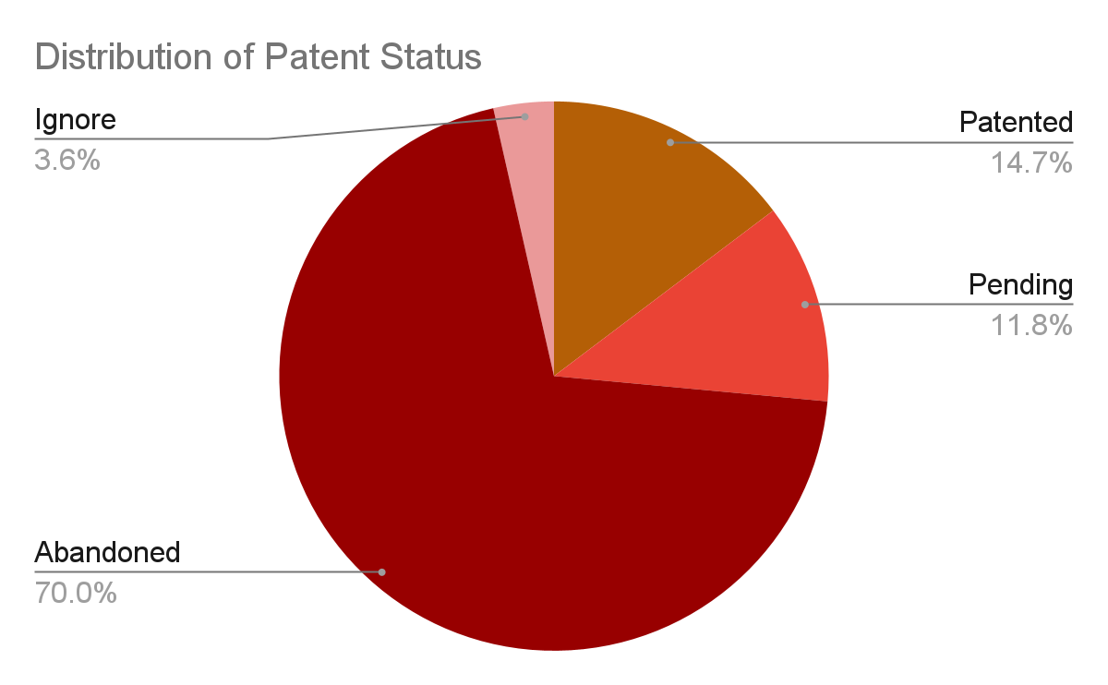
The attrition rate in both the modeling and licensing processes are a major issue
Attrition rate in the patenting process is 70%
67% of inventions never get licensed

Slide 11
The patenting and licensing process occur simultaneously and are bucketed into two categories for modeling
Patenting Categorizations
Licensing Categorizations
Fund | Patented | Patent has been issued
 | Pending | Patent process ongoing
Do Not Fund | Abandoned | Patent process abandoned
 | Ignore | Inventions not eligible for patenting
Likely to License | Licensed | License has been executed
 | Could License | Licensing process ongoing
Unlikely License | Never License | Licensing process terminated
 | Ignore | Inventions not eligible for licensing
Notes:
Consider consolidating buckets

Slide 12


Pre-processing included refinement of patenting and invention data
Preprocessing
Patents
Technologies
Create binary “fund/no fund” outcome variable
Calculate number of inventors per patent
Consolidate various date fields
Filter IP types to “patents”
Consolidate school divisions
Merge innovation description text fields

Slide 13
Feature Engineering - Specific Steps
Limit entries to unique “Tech_Title”, “Patent_Title”, “Disclosure_Date”, and “Country_WIPO_ID” combinations
Pick the entry with the earliest available ”Actually_Filed_Date”
Detect Duplicates
Count number of patents in each school division and tech family
Calculate patent success rate by school division and tech family
Cluster patents by topics
Add Features
Impute & Scale
Conduct KNN imputation
Manually impute null values not subject to KNN Imputation
Perform integer encoding for categorical data;
Scale data using MinMaxScaler

Slide 14
Feature engineering included limiting to unique records, adding patent features and prepping records for modeling
Identify what a “unique record” is for the tech transfer team (TTO).
Detect Duplicates
Develop new features using existing TTO data
Add Features
Impute & Scale
Fill data gaps, optimize features for modeling

Slide 15
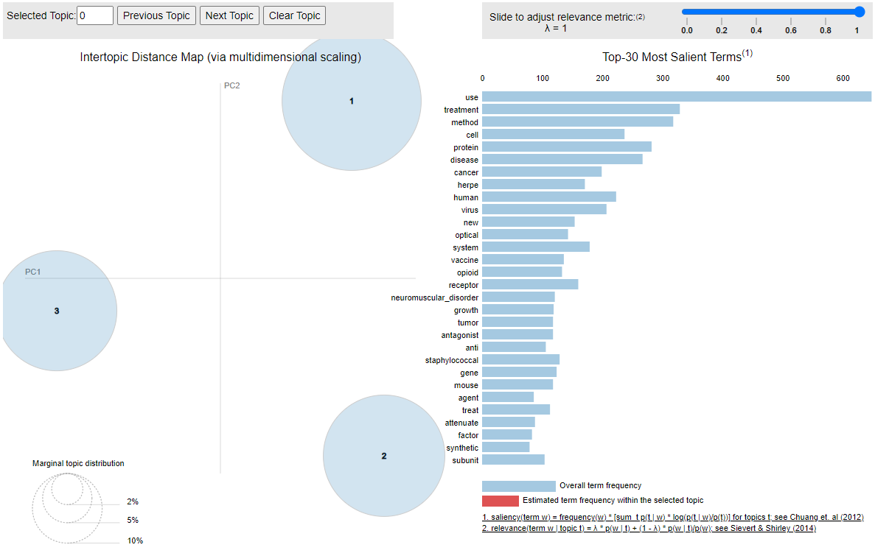
EDA through topic modeling identified three topics
Topic 1: Physical Sciences
method
protein
disease
human
virus
Topic 2: Biological Sciences
treatment
cell
cancer
opioid
growth
Topic 3: Other
use
herpe
new
optical
vaccine
Intertopic Distance

Slide 16
Modeling Considerations
Model
Model Type
Primary Metric
Primary Features
Output
1
Which patents should the Polsky Center select?
Binary Classification
F1
Priority Status
Disclosure-Filing Time
Patents in Family
Fund /
Do not Fund
2
What inventions have a high probability of licensing success?
Binary Classification
F1
Technology Owner
Licenses in Technology
Date of Filing
Likely to License /
Unlikely to License
Equal importance on Type I and Type II Error
Notes:
2x2 matrix. Simplify table. Get rid of red and use box. Saving money and making this decision making process simple

Slide 17
Additional models considered
Models | Train F1 Score | Test F1 Score | CV F1 Score
Patenting Models
Random Forest | 95.5 | 93.6 | 92.7
Gradient Boost | 97.2 | 94.1 | 92.6
XGBoost | 94.9 | 92.3 | 91.6
Licensing Models
Random Forest | 99.2 | 91.9 | 90.2
Gradient Boost | 92.3 | 91.1 | 89.7
XGBoost | 94.2 | 89.3 | 90.3
Notes:
Emphasize decision making process. Build on process, build model, test scores, finalize. Highlight the steps. Think about breaking out process slide and combining info here

Slide 18
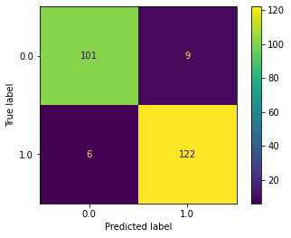
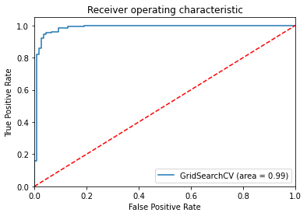
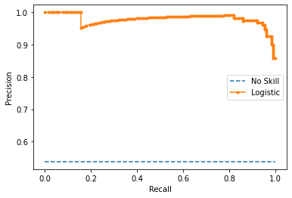
Patenting model outputs
Random Forest Patent Model Outputs
Notes:
Add slide saying WHAT these scores mean, what it gives

Slide 19
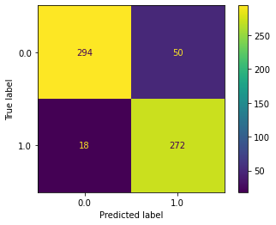
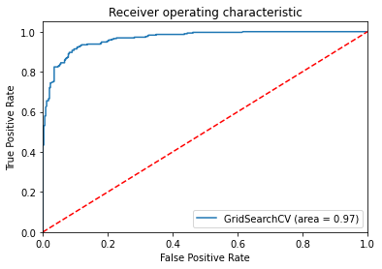
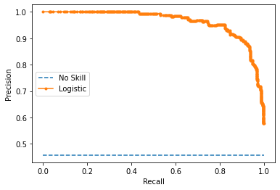
Licensing model outputs
XGBoost Licensing Model Outputs

Slide 20
Modeling outputs give the technology managers immediate recommendations on inventions, simplifying the selection process.
Should we fund this invention?
Is this invention likely to be licensed?
Do Not Fund
Unlikely
Fund
Likely
The model was able to make these predictions using data available at, or prior to, the associated filing date

Slide 21
Models increasing generalizability and equally addressing Type I and Type II errors were selected
Models | Train F1 Score | Test F1 Score | CV F1 Score
Patenting Model
Random Forest | 95.5 | 93.6 | 92.7
Licensing Models
XGBoost | 94.2 | 89.3 | 90.3
Model Selection Methodology
Models are selected based on cross validation (CV) F1 score
Models are tuned to minimize gap between train, test and CV scores
Generalizable models will be more receptive to new Polsky Center Data

Slide 22
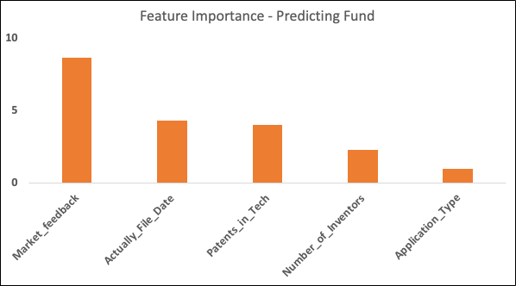
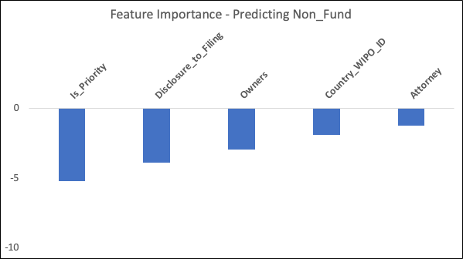
Feature importance gives the Polsky Center insight on how to move inventions from “No Fund” to “Fund”
Feature Importance shows how to improve the efficiency and effectiveness of a predictive model on the problem.
These are parameters that can be tuned to go from “No Fund” to “Fund”, unlocking the black box associated with modeling
Notes:
Market Feedback is a binary Yes/No field

Slide 23
A refined selection process saves the TTO resources spent manually selecting inventions
Identify the new cohort of perspective inventions
Run invention prospects through modeling
Select inventions based on patenting and licensing selections
Extract key features to work with inventors on optimized invention characteristics
Deliverables include a script to complete steps 2-4 above and a modeling analysis script to ensure models are optimized as new data becomes available

Slide 24
A refined selection process saves the TTO time, money and resources, allowing for more success invention funding
Cost Savings
Explainable A.I.
~$7,700 savings per patent from identification of unsuccessful patent applications
Identification of key features associated with successful inventions
Polsky Center refined invention selection process
Examination of more patents, increasing capacity scale
Increased Throughput
24

Slide 25
Suggestions, Limitations and Future Work include new features, additional data, and modeling by sub-categories
Convert Fund/No-Fund classification to investment amount for each patent
Adjust prediction probability threshold based on available funding resources
Add success rates by country, cost, etc.
Include data from different institutions in the model
Train the model using only the top features
Include a pre-filing model without features that come in later in the process the the Fund/No Fund decision can be made even earlier
Include an indicator for if an invention has been licensed at time of filing

